Slide 1

Medical Insurance Cost Prediction
Comparing Linear Regression, Decision Tree, and Random Forest models
REGRESSION PROJECT
DATA SCIENCE

Slide 2
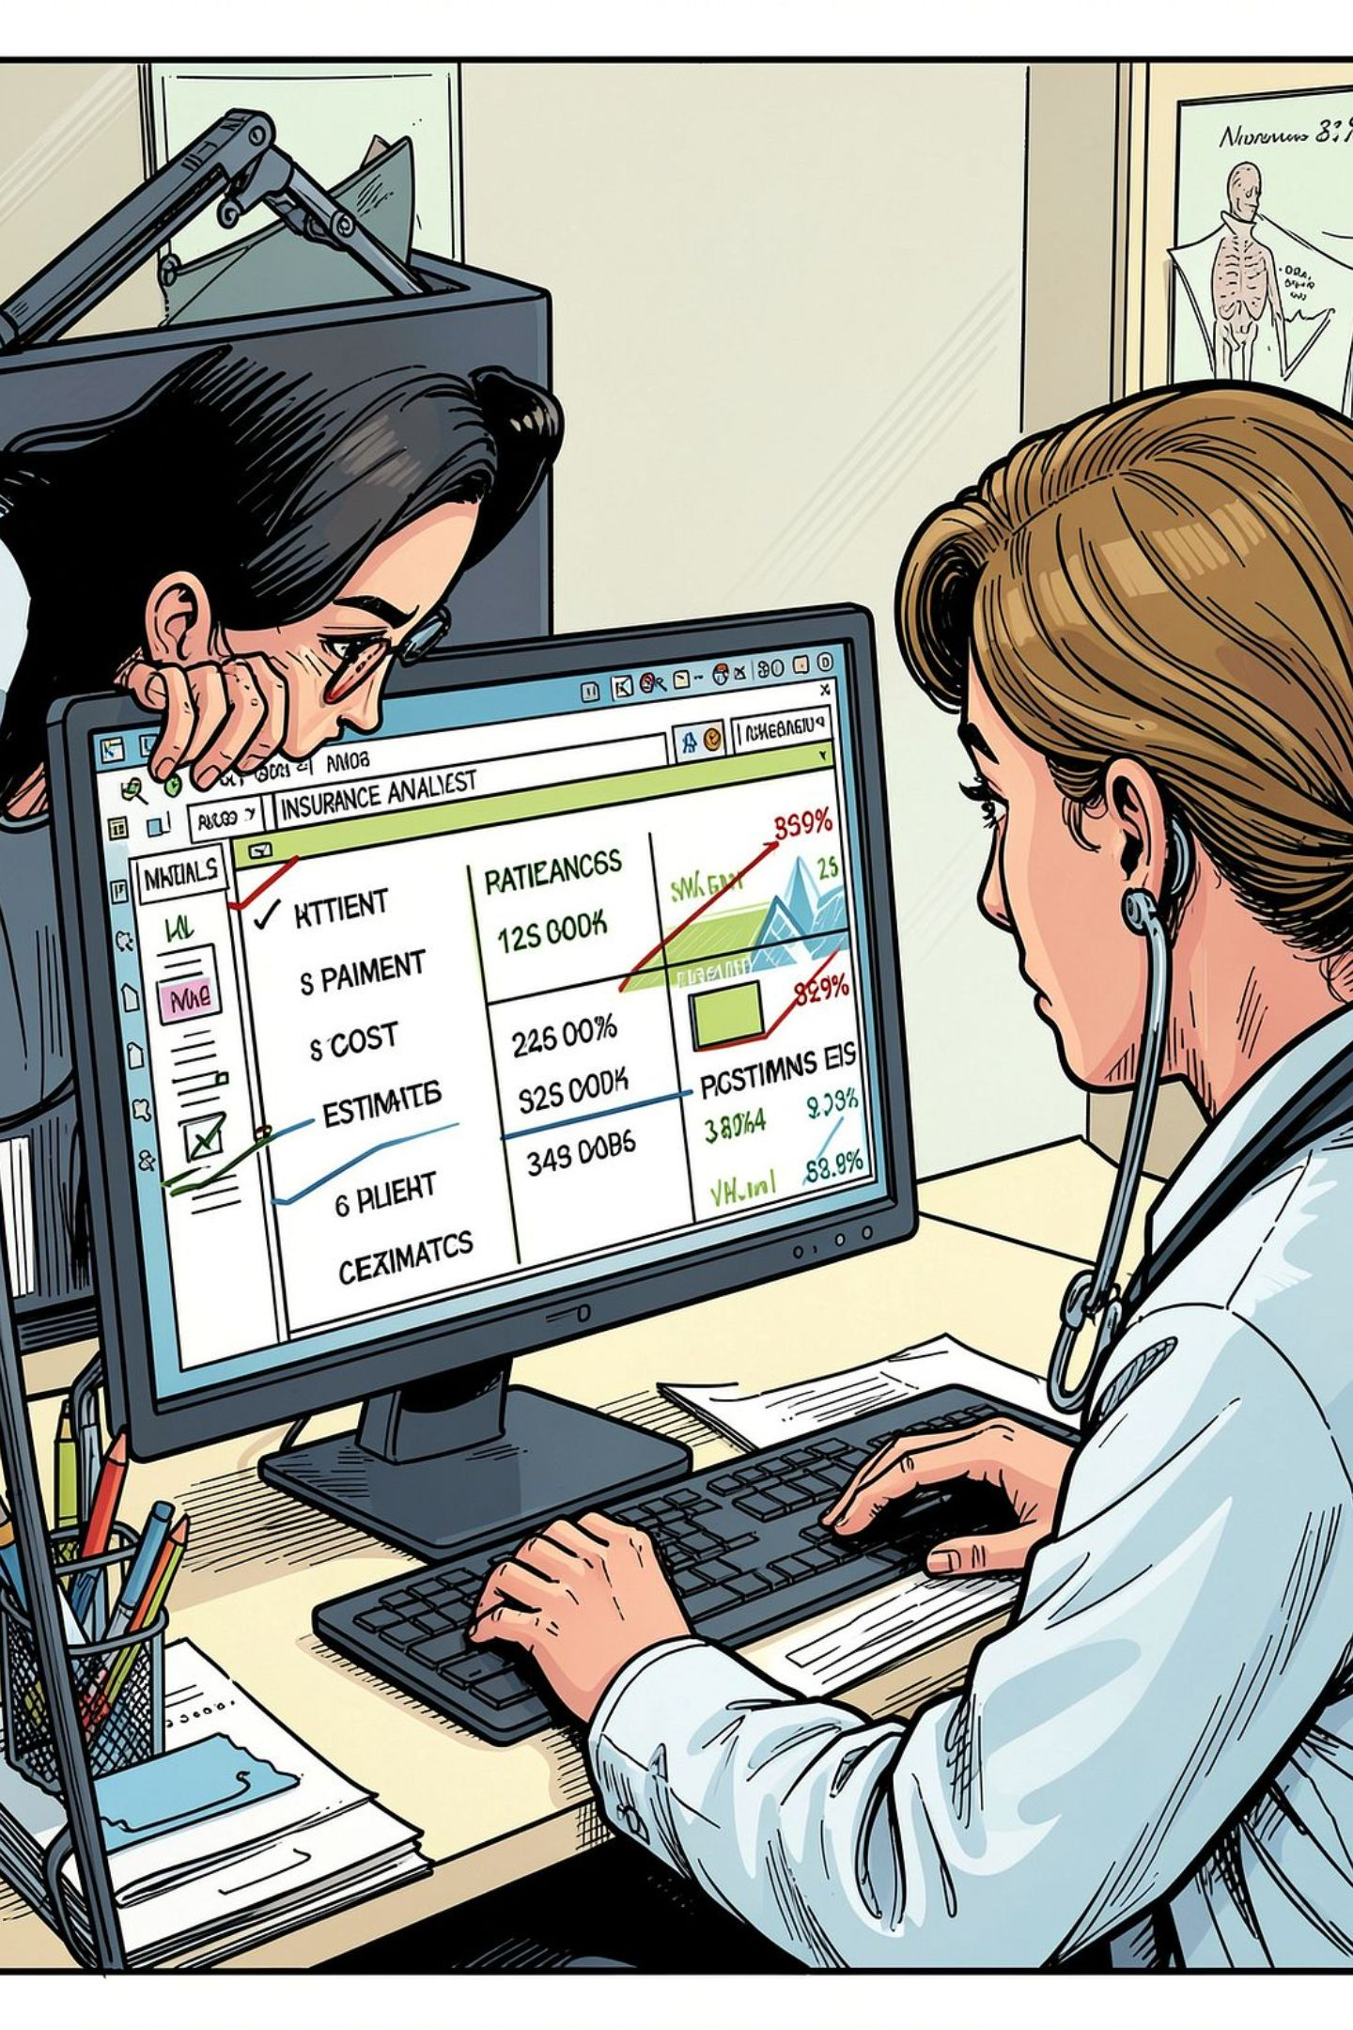



Problem Statement & Objective
The Challenge
Insurance companies must estimate medical costs accurately to price policies fairly — without access to full medical histories, this is a complex regression problem.
Our Goal
Build and compare three regression models to predict the charges column from patient data: age, sex, BMI, children, smoker status, and region.
Github Repo : https://github.com/SalehAhmed-Ai/insurance_regression_project.git
Deployment:Medical Insurance Cost Prediction · Streamlit

Slide 3
Dataset Overview
Medical Cost Personal Datasets (Kaggle) — a widely used benchmark for healthcare cost prediction.
1,338
7
Rows
Columns
Patient records
Features + target
6
1
Features
Target
age, sex, bmi, children, smoker, region
charges (USD)

Slide 4

Data Preprocessing
01
Cleaning
Checked for missing values and duplicates — none found in this dataset.
02
Encoding
One-hot encoded categorical variables: sex, smoker, and region.
03
Scaling
Standard scaling applied for Linear Regression; tree-based models used unscaled data.
04
Train / Test Split
80/20 split with fixed random seed for reproducibility.

Slide 5
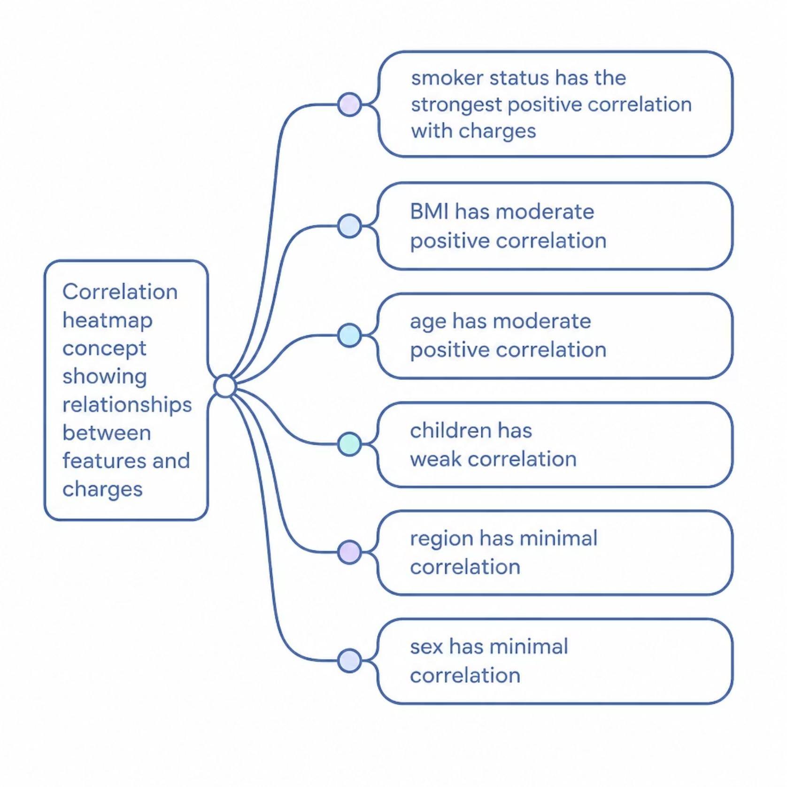
Exploratory Data Analysis — Key Insights
🚬 Smoking Status
⚖️ BMI & Age
The single strongest driver of charges — smokers pay dramatically more than non-smokers.
Both show positive correlation with charges — higher BMI and older age increase predicted costs.
👨‍👩‍👧 Children & Region
Weaker signals — number of children and geographic region have minimal direct impact on charges.

Slide 6
Feature Engineering
Thoughtful feature creation improved model performance — and rigorous testing helped us reject ideas that didn't work.
✅ Success: bmi_smoker Interaction
❌ Rejected: Log-Transform Target
Created BMI × smoker interaction term. Linear Regression R² rose from 0.807 → 0.886. Captures the compounding effect of high BMI in smokers.
Log-transforming charges was tested to normalize the skewed target. Result: R² dropped to 0.588. Rejected based on evidence.

Slide 7
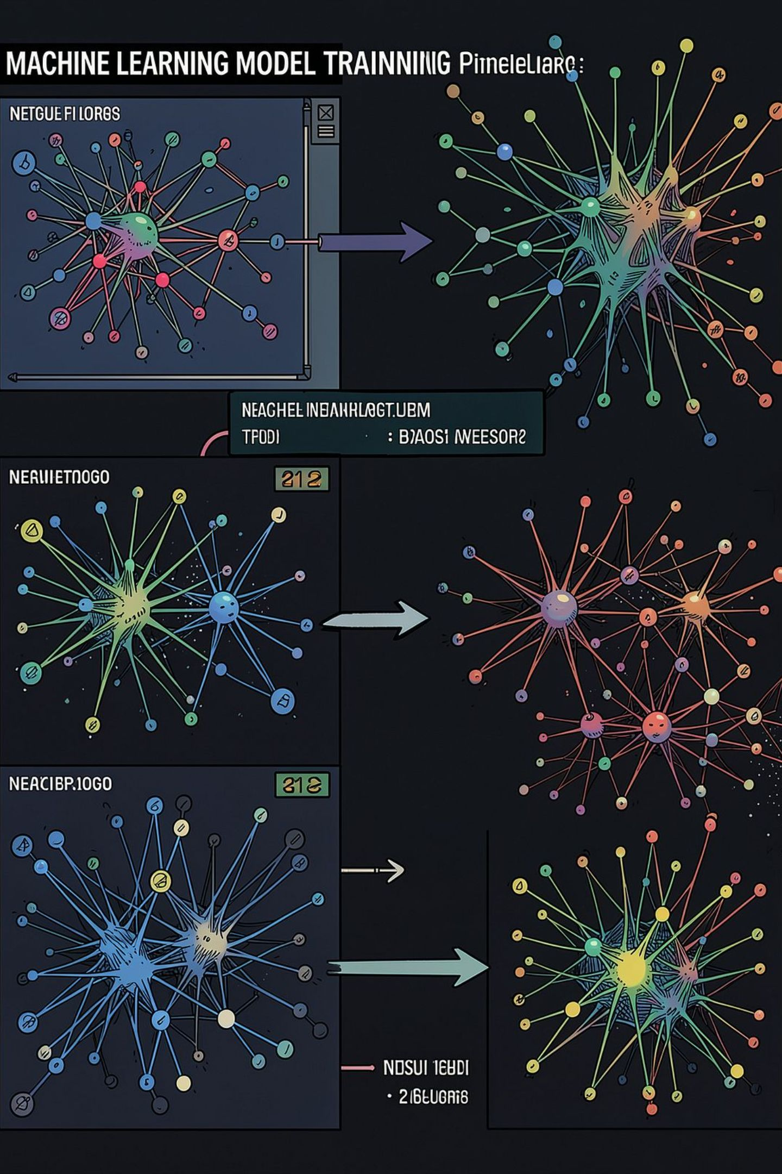



Models Trained
Linear Regression
Baseline model with interpretable coefficients. Scaled features used. Hyperparameters tuned via GridSearchCV.
Decision Tree
Non-linear model capturing feature interactions naturally. Pruned via GridSearchCV to prevent overfitting.
Random Forest
Ensemble of decision trees with bagging. Robust to outliers and non-linear patterns. Tuned with GridSearchCV.

Slide 8
Model Comparison Results
Model
R² Score
MAE ($)
RMSE ($)
Rank
Random Forest
0.901
2,414.5
4,261.8
🏆 1st
Decision Tree
0.892
2,693.3
4,461.4
2nd
Linear Regression
0.886
2,829.0
4,572.8
3rd
Why Random Forest Wins
Ensemble methods naturally capture non-linear interactions (e.g., smoker × BMI) without explicit feature engineering — outperforming linear models on this dataset.

Slide 9

Deployment & Team Workflow
🌐 Streamlit Web App
Users enter patient details (age, BMI, smoker status, etc.), select a model, and receive an instant predicted insurance cost.
👥 Team of 5 — Full Pipeline
Preprocessing — data cleaning & encoding
EDA — exploratory analysis & insights
Modeling — training & tuning models
Evaluation — metrics & comparison
Deployment — Streamlit app & documentation

Slide 10
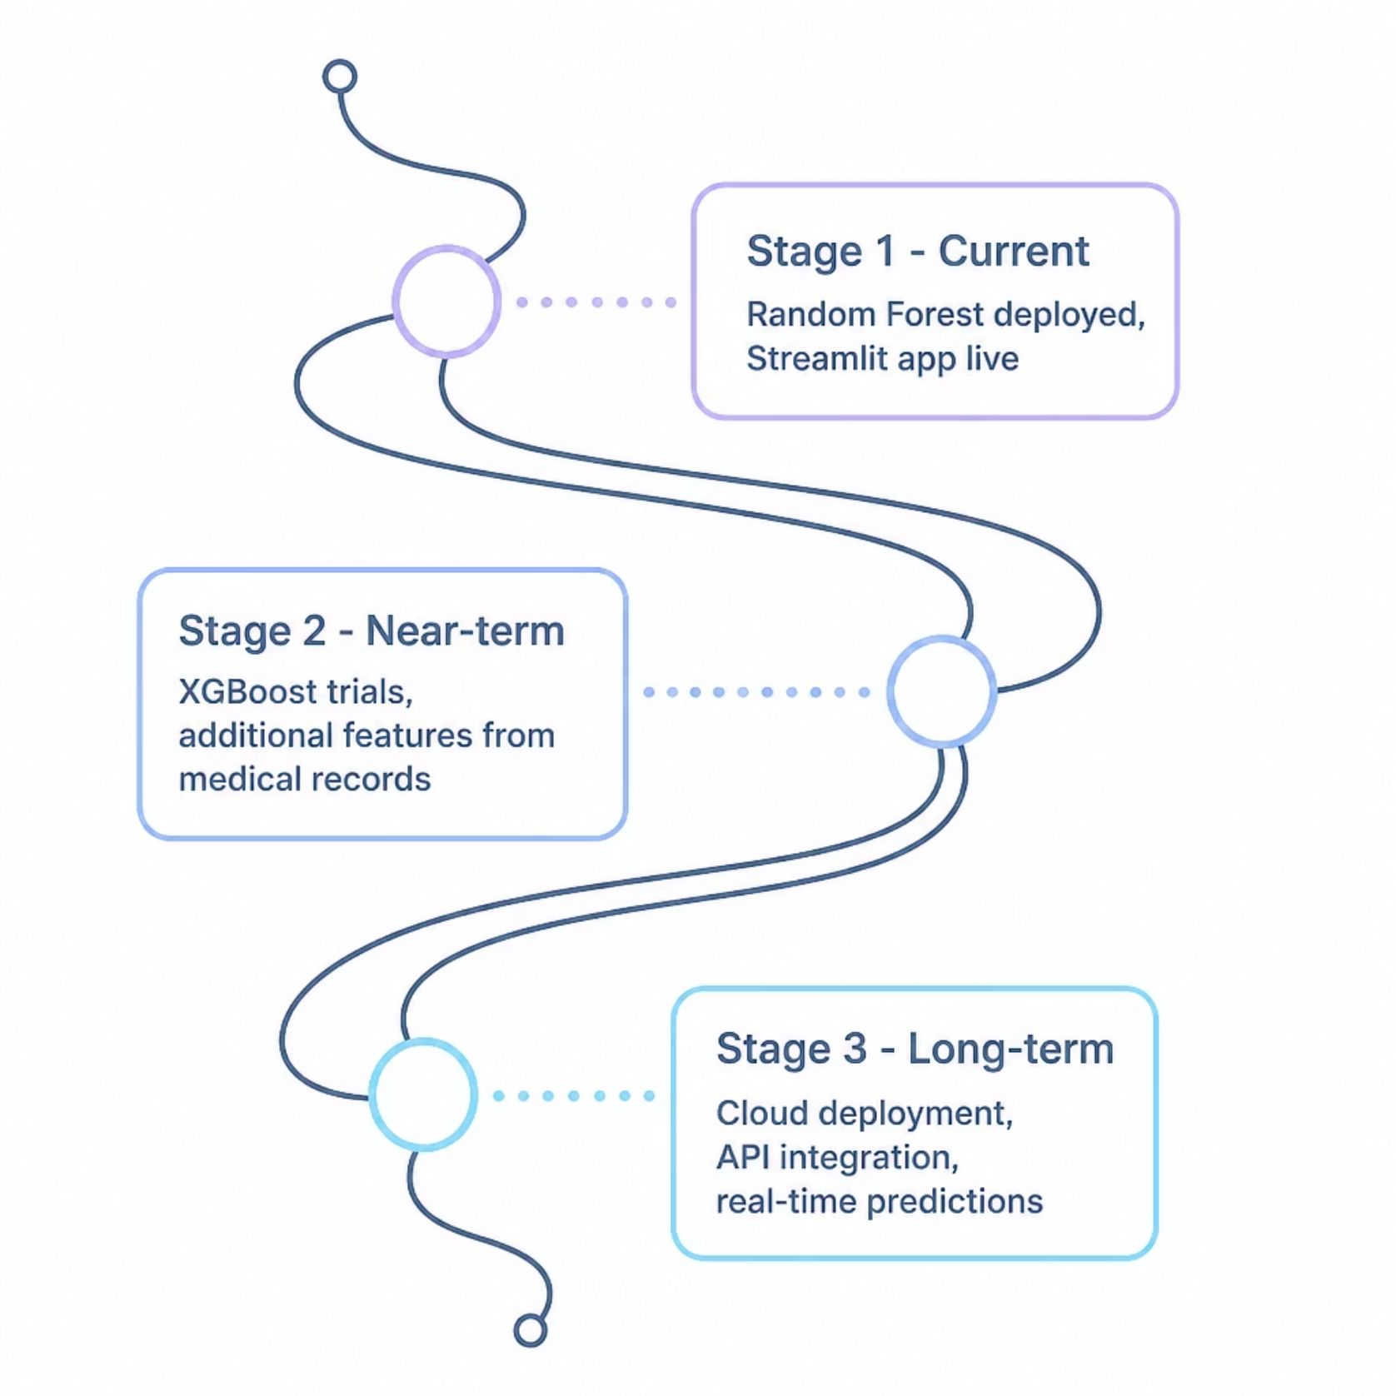

Conclusion & Future Work
🏆 Recommended Model
📈 Next Steps
Random Forest — highest R² (0.901), lowest MAE and RMSE. Ready for production deployment.
Experiment with Gradient Boosting / XGBoost
Enrich features with medical history data
Deploy on cloud infrastructure (AWS / GCP)

